Slide 1
Credit Card Transactions (Detecting Fraud) Analyzing Transaction Data By RIZWANA ABDUL RASHEED

Slide 2
Introduction
What is Fraud Detection?
Fraud detection is the process of identifying suspicious transactions that may be fraudulent. This involves analyzing transaction data to spot unusual patterns or behaviors that could indicate fraud. The goal is to protect consumers and financial institutions from financial losses and maintain trust in the financial system.
Key Points:
Identifying Suspicious Transactions: Using various techniques, such as machine learning models and rule-based systems, to detect anomalies in transaction data.
Protecting Consumers and Financial Institutions: Ensuring that fraudulent activities are identified and prevented, thereby safeguarding the interests of both consumers and financial institutions.

Slide 3
Dataset Overview
Description of the Dataset:
This dataset contains credit card transactions, including both legitimate and fraudulent transactions. It is designed to help analyze spending patterns and detect fraudulent activities.
Key Features:
Transaction ID: A unique identifier for each transaction.
Date and Time: The timestamp when the transaction occurred.
Amount: The monetary value of the transaction.
Merchant: The vendor or service provider where the transaction took place.
Category: The type of transaction (e.g., groceries, entertainment).

Slide 4
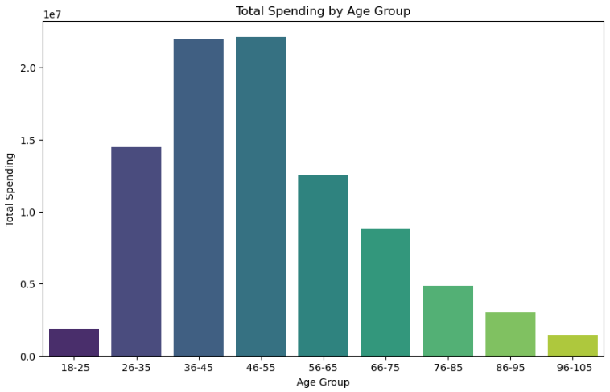
Data Exploration

Slide 5
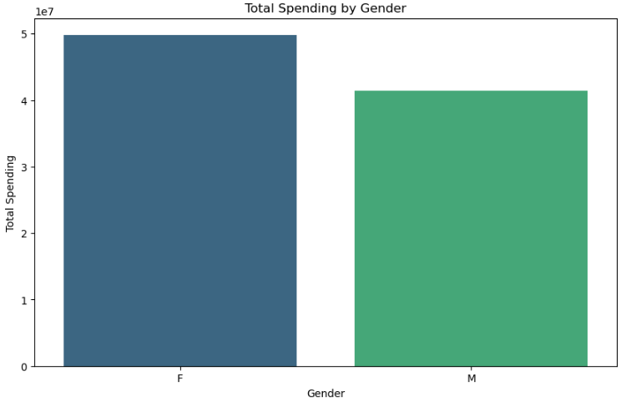

Slide 6
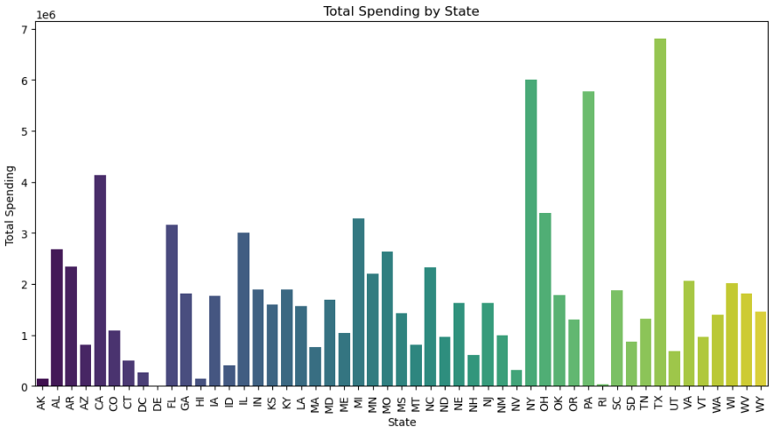

Slide 7
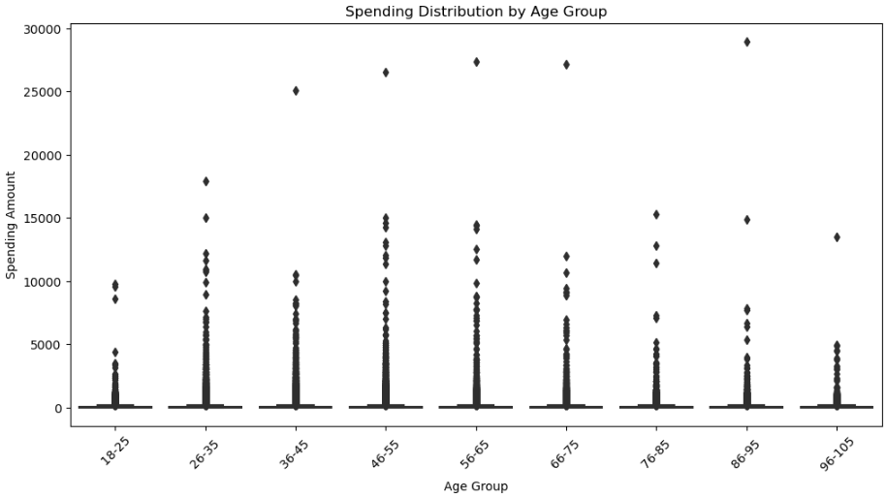

Slide 8
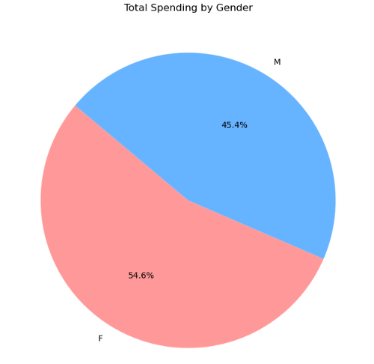

Slide 9
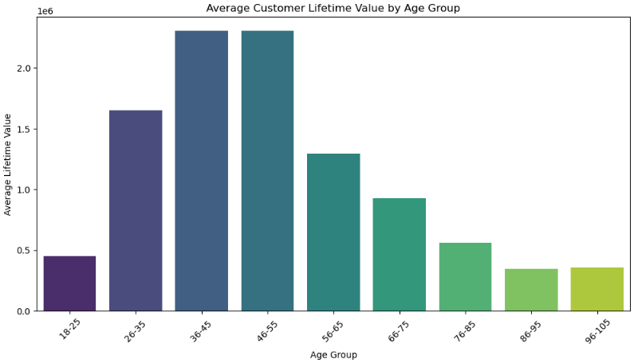

Slide 10
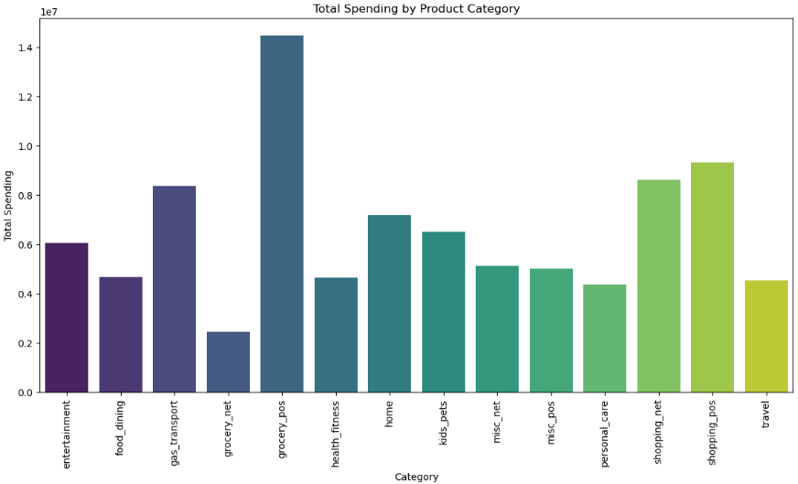

Slide 11
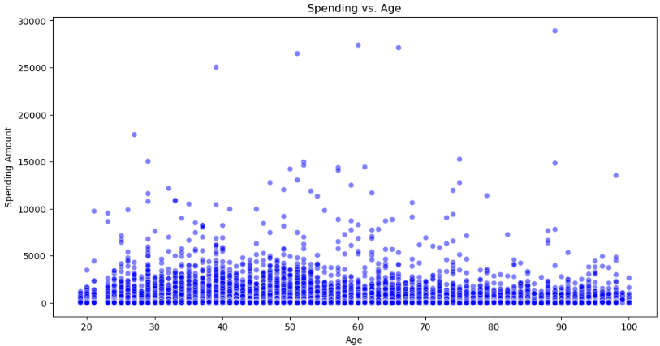

Slide 12
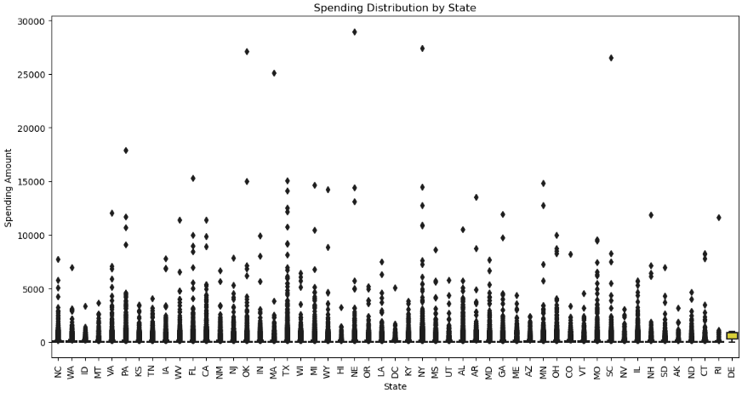

Slide 13
Current market analysis
We have identified important key trends that demand our attention.
Data reveals a steady increase in consumer demand for sustainable products, presenting an opportunity for our eco-friendly offerings.
Our competitors are now focusing on digital marketing strategies, suggesting a shift in consumer behavior.
Understanding these nuanced dynamics positions us to adapt and capitalize on emerging market preferences.

Slide 14

Market Expansion
Unlocking new horizons

Slide 15
Product launch
Product launch timeline
Q3
Market research
Q4
Product development
Q1
User testing
Q2
Product launch
Currently gearing up for a ground-breaking launch
Our new offerings will captivate the market
Our marketing campaign will generate anticipation

Slide 16

Marketing strategies
Implement personalized engagement strategies
Tailor campaigns to resonate with specific demographics, fostering a sense of relevance and connection
Collaborate with influencers and thought leaders to amplify our brand message

Slide 17
Financial overview
Our financial overview reflects a robust and resilient fiscal performance.
Key indicators show consistent revenue growth over the past quarter, attributed to strategic cost management and successful marketing.
Operating margins have improved, signaling operational efficiency, while strengthening our reserves.
This underscores our commitment to financial stability, positioning us for sustained growth.

Slide 18
Quarterly targets
Market expansion
Product innovation
Customer retention
Operational efficiency
Quarter | Revenue growth (%) | Market share increase (%) | Customer acquisition
Q1 | 12 | 2 | 500
Q2 | 15 | 3 | 600
Q3 | 18 | 4 | 700
Q4 | 20 | 5 | 800

Slide 19
Financial snapshot
Metric | Current value | Previous quarter | Change (%)
Revenue | $2,500,000 | 2,200,000 | +14%
Operating expenses | $1,200,000 | $1,400,000 | -14%
Net profit | $1,000,000 | $800,000 | +25%
Operating margin | 40% | 36% | +4%
Cash reserves | $5,000,000 | $4,500,000 | +11%

Slide 20

Innovative solutions

Slide 21
Future initiatives
Product enhancement. Introduce regular updates and features to enhance product offerings.
Technology integration. Explore emerging technologies for potential integration into our operations.
Collaborative partnerships. Foster collaborations with tech innovators and industry leaders to drive innovation.
Green supply chain
Reduced carbon footprint
Waste reduction
Water conservation

Slide 22
Thank you
Sonu Jain | sjain@contoso.com | www.contoso.com

